Slide 1

C++ Programming: From Problem Analysis to Program Design, Fifth Edition
Chapter 7: User-Defined Functions II

Slide 2
Download textbook
Read through
Try examples using Dev C++
Try End of chapter problems
Do that in groups

Slide 3
Void Functions
Void functions and value-returning functions have similar structures
  Both have a heading part and a statement part
User-defined void functions can be placed either before or after the function main
If user-defined void functions are placed after the function main
  The function prototype must be placed before the function main

Slide 4
Void Functions (cont'd.)
A void function does not have a return type
  return statement without any value is typically used to exit the function early
Formal parameters are optional
A call to a void function is a stand-alone statement

Slide 5
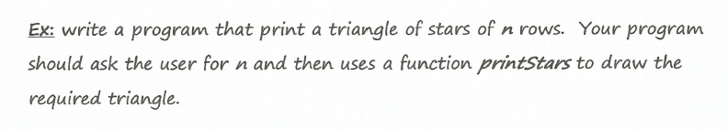
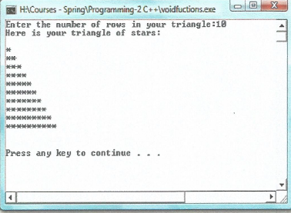
Void Functions (cont'd.)
Example 7-3 P364 in textbook
Expected output
for n=10

Slide 6
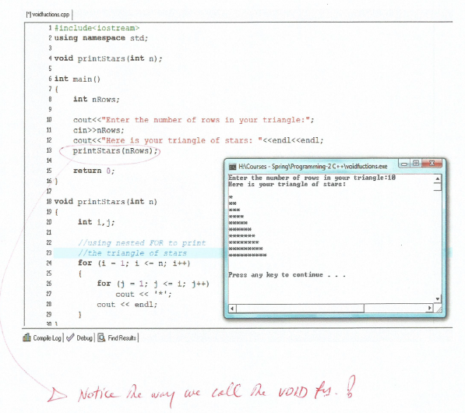

Slide 7
Value and Reference Parameters
Value parameter: a formal parameter that receives a copy of the content of corresponding actual parameter
Reference parameter: a formal parameter that receives the location (memory address) of the corresponding actual parameter

Slide 8
Function Value Parameters
If a formal parameter is a value parameter
  The value of the corresponding actual parameter is copied into it
The value parameter has its own copy of the data
During program execution
  The value parameter manipulates the data stored in its own memory space

Slide 9
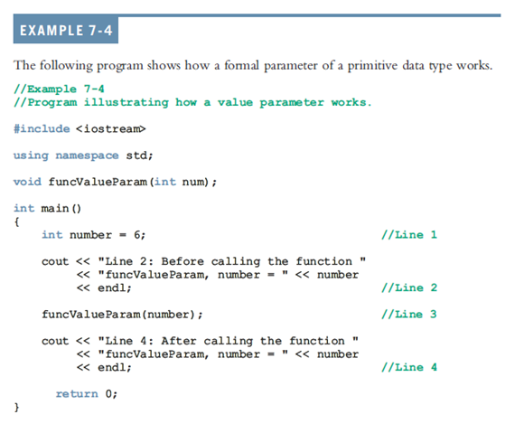
P367 in textbook

Slide 10
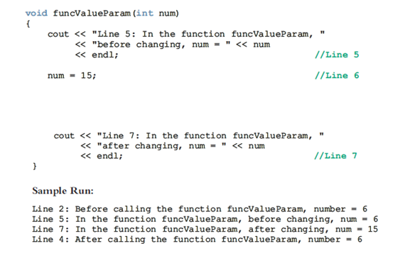

Slide 11
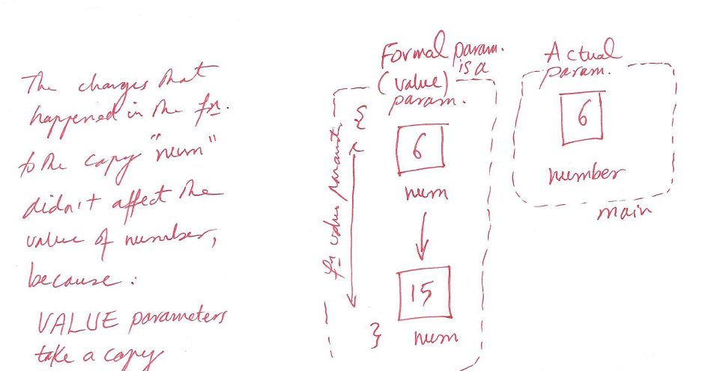

Slide 12
Before using Call by Reference
We Check how Pointers work in C++
Recall the data type int. The set of values belonging to this data type includes integers that range between –2147483648 and 2147483647, and the operations allowed on these values are the arithmetic operators.
Now, we describe the pointer data type.

Slide 13
Pointers in C++
The values belonging to pointer data types are the memory addresses of your computer.
The set of values of a pointer data type—is the addresses (memory locations), a pointer variable is a variable whose content is an address, that is, a memory location.
There is no name associated with the pointer data type in C++.

Slide 14
Pointers in C++
In C++, you declare a pointer variable by using the asterisk symbol (*) between the data type and the variable name. The asterisk is called dereferencing operator or indirection operator.
Example:
    int *p;
In C++, the ampersand (&), called the referencing operator, address of operator, is a unary operator that returns the address of its operand.

Slide 15
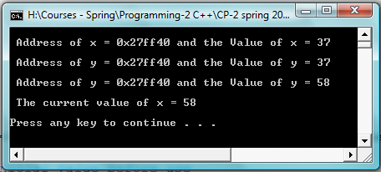
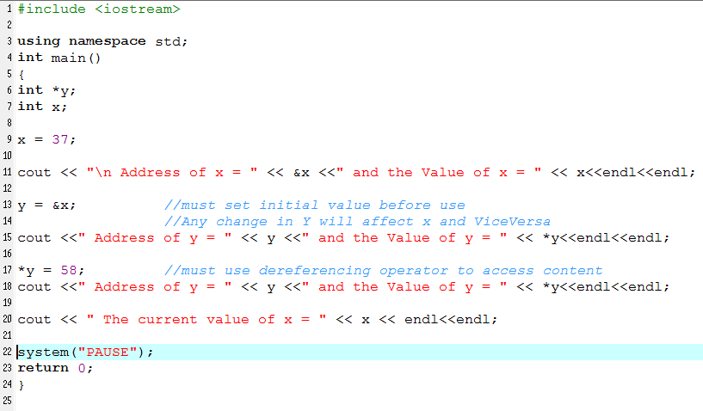
Pointers in C++
Example 14-3 P799 in textbook

Slide 16
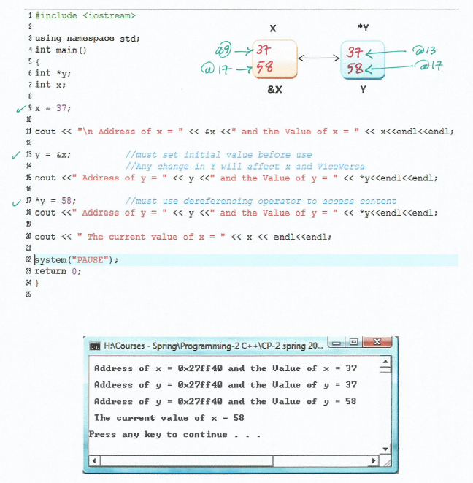

Slide 17
Reference Variables as Parameters to functions
If a formal parameter is a reference parameter
  It receives the memory address of the corresponding actual parameter
A reference parameter stores the address of the corresponding actual parameter
During program execution to manipulate data
  The address stored in the reference parameter directs it to the memory space of the corresponding actual parameter

Slide 18
Reference Variables as Parameters (cont'd.)
Reference parameters can:
  Pass one or more values from a function
  Change the value of the actual parameter
Reference parameters are useful in three situations:
  Returning more than one value
  Changing the actual parameter
  When passing the address would save memory space and time

Slide 19
Example 7-5
P369 in Text
Write a program that reads a course score (a value between 0 and 100) and determines the student’s course grade using the following function prototypes:
    void getScore(int& score);
    void printGrade(int score);

Slide 20
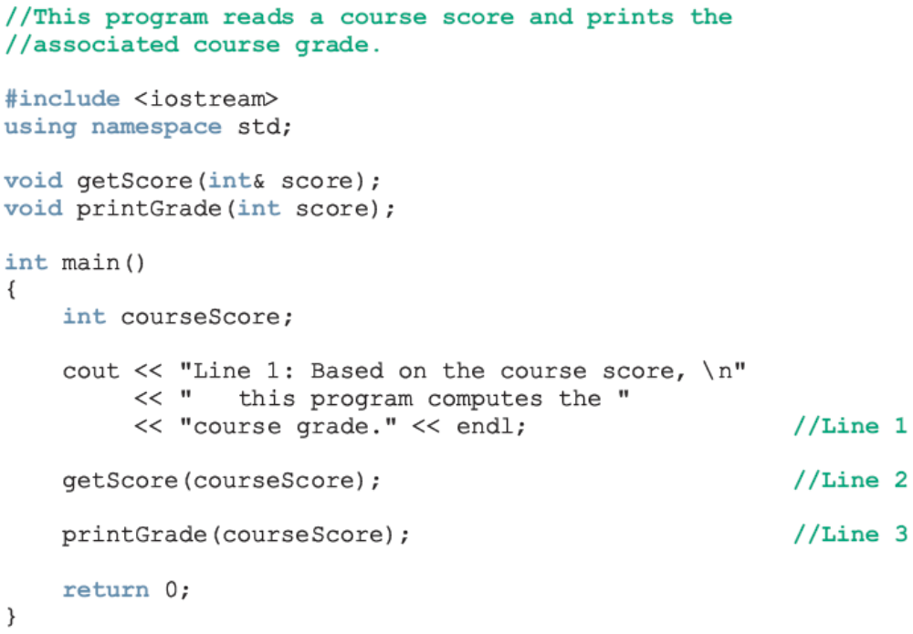
Example 7-5: Calculate Grade
Notice the Structured Programming Approach!

Slide 21
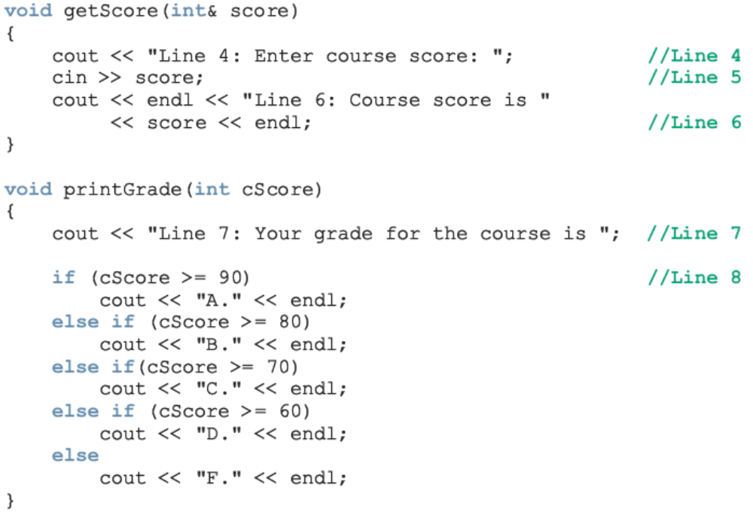
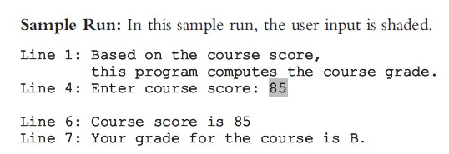
Example 7-5: Calculate Grade (cont'd.)

Slide 22
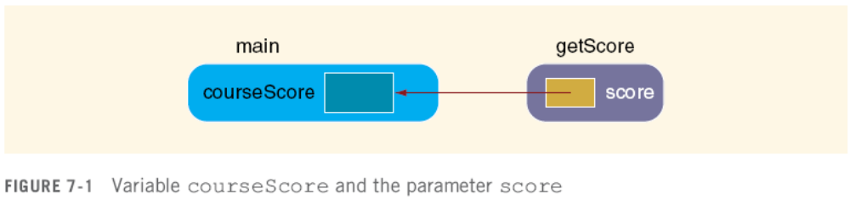
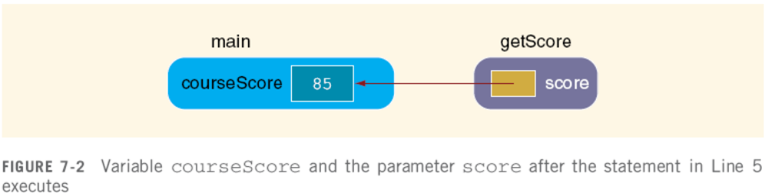
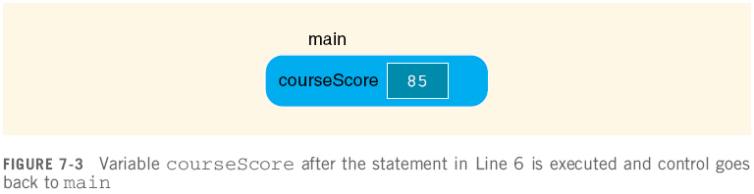

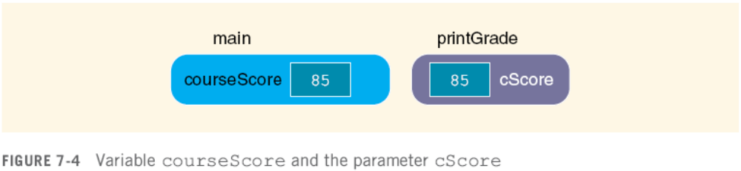
Example 7-5: Calculate Grade (cont'd.)

Slide 23
Value and Reference Parameters and Memory Allocation
When a function is called
  Memory for its formal parameters and variables declared in the body of the function (called local variables) is allocated in the function data area
In the case of a value parameter
  The value of the actual parameter is copied into the memory cell of its corresponding formal parameter

Slide 24
Value and Reference Parameters and Memory Allocation (cont'd.)
In the case of a reference parameter
  The address of the actual parameter passes to the formal parameter
Content of formal parameter is an address
During execution, changes made by the formal parameter permanently change the value of the actual parameter
Stream variables (e.g., ifstream) should be passed by reference to a function

Slide 25
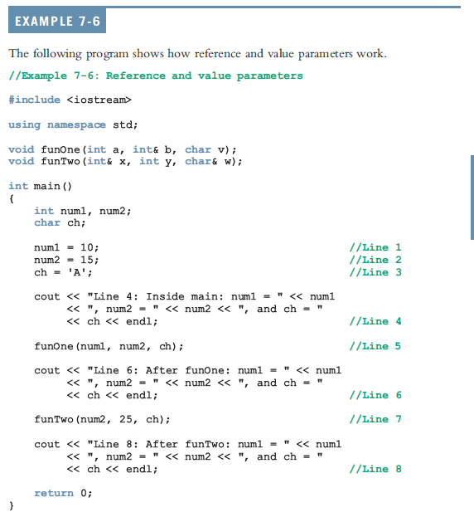
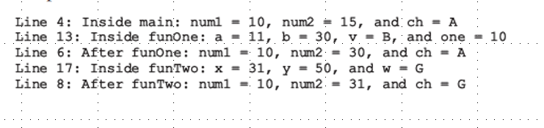
Value and Reference Parameters and Memory Allocation (cont'd.)

Slide 26
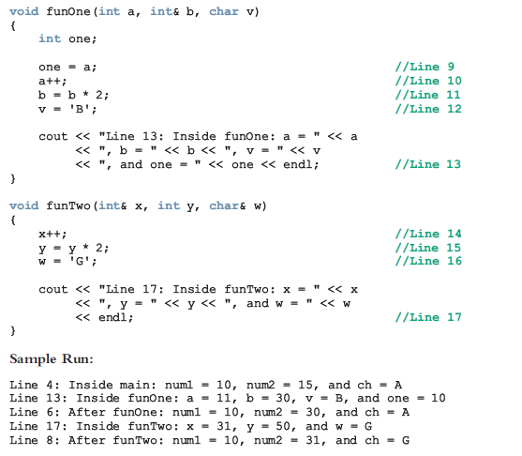
Value and Reference Parameters and Memory Allocation (cont'd.)

Slide 27
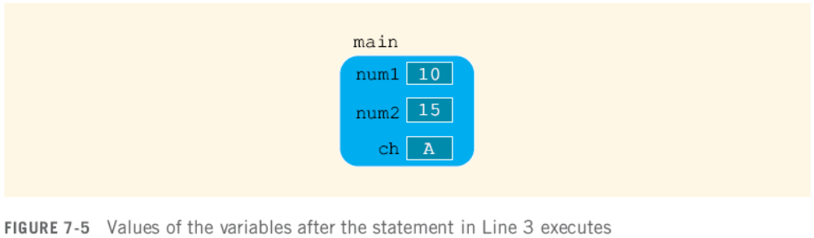
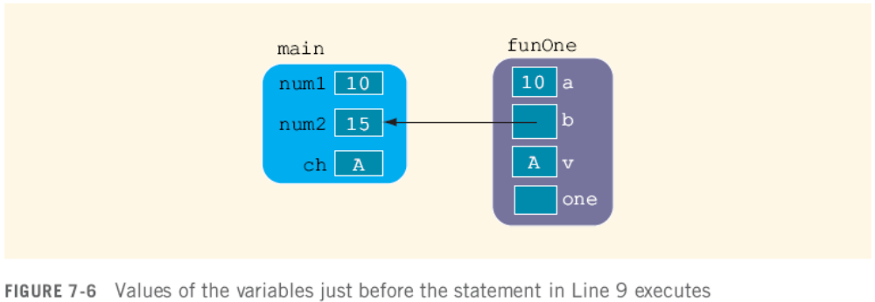
Value and Reference Parameters and Memory Allocation (cont'd.)

Slide 28
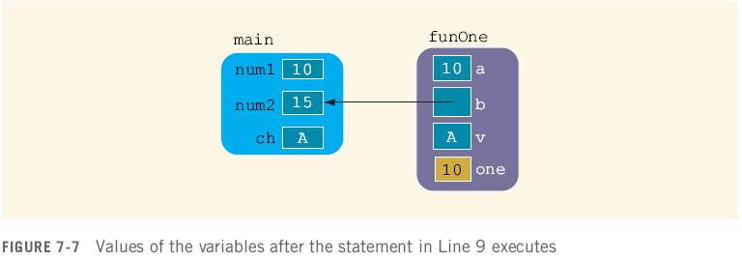

Value and Reference Parameters and Memory Allocation (cont'd.)

Slide 29


Value and Reference Parameters and Memory Allocation (cont'd.)

Slide 30
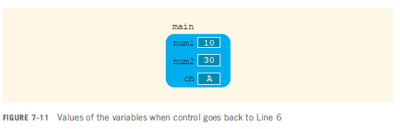
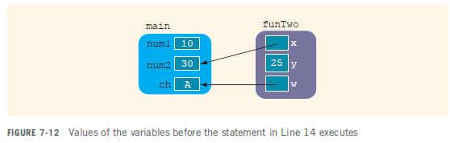
Value and Reference Parameters and Memory Allocation (cont'd.)

Slide 31
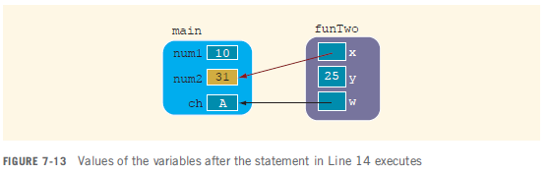
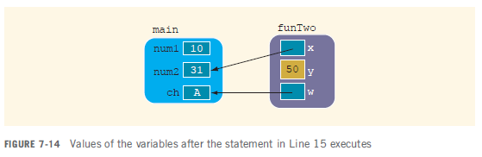
Value and Reference Parameters and Memory Allocation (cont'd.)

Slide 32
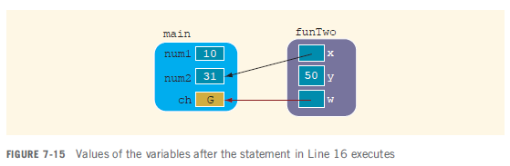

Value and Reference Parameters and Memory Allocation (cont'd.)

Slide 33
Reference Parameters and Value-Returning Functions
You can also use reference parameters in a value-returning function
  Not recommended
By definition, a value-returning function returns a single value
  This value is returned via the return statement
If a function needs to return more than one value, you should change it to a void function and use the appropriate reference parameters to return the values

Slide 34
Scope of an Identifier
The scope of an identifier refers to where in the program an identifier is accessible
Local identifier: identifiers declared within a function (or block)
Global identifier: identifiers declared outside of every function definition
C++ does not allow nested functions
  The definition of one function cannot be included in the body of another function

Slide 35
Scope of an Identifier (cont'd.)
Rules when an identifier accessed:
  Global identifiers
    Declared before function definition
    Function name different from identifier
    Parameters to function have different names
    All local identifiers have different names

Slide 36
Scope of an Identifier (cont'd.)
  Nested block
    Identifier accessible from declaration to end of block
    Within nested blocks if no identifier with same name exists
  Scope of function name similar to scope of identifier declared outside any block

Slide 37
Scope of an Identifier (cont'd.)
Some compilers initialize global variables to default values
The operator :: is called the scope resolution operator
By using the scope resolution operator
  A global variable declared before the definition of a function (block) can be accessed by the function (or block)
  Even if the function (or block) has an identifier with the same name as the variable

Slide 38
Scope of an Identifier (cont'd.)
C++ provides a way to access a global variable declared after the definition of a function
  In this case, the function must not contain any identifier with the same name as the global variable

Slide 39
Global Variables, Named Constants, and Side Effects
Using global variables causes side effects
A function that uses global variables is not independent
If more than one function uses the same global variable and something goes wrong
  It is difficult to find what went wrong and where
  Problems caused in one area of the program may appear to be from another area
Global named constants have no side effects

Slide 40
Static and Automatic Variables
Automatic variable: memory is allocated at block entry and de-allocated at block exit
  By default, variables declared within a block are automatic variables
Static variable: memory remains allocated as long as the program executes
  Variables declared outside of any block are static variables
  Declare a static variable within a block by using the reserved word static

Slide 41

Static and Automatic Variables (cont'd.)
The syntax for declaring a static variable is:
The statement
static int x;
  declares x to be a static variable of the type int
Static variables declared within a block are local to the block
  Their scope is the same as any other local identifier of that block

Slide 42
Static and Automatic Variables (cont'd.)
Example 7-9 in Text Book P391

Slide 43
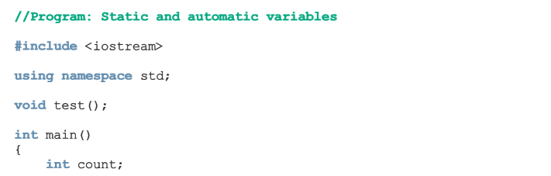
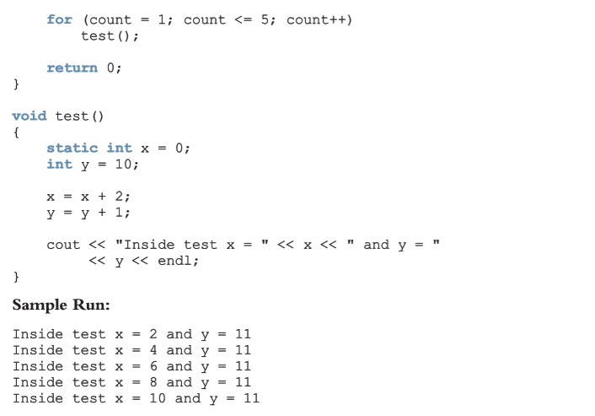

Slide 44
Debugging: Using Drivers and Stubs
Driver program: separate program to test a function
  Make sure that each function is working properly
When results calculated by one function are needed in another function
  Use a stub: function that is not fully coded

Slide 45
Function Overloading: An Introduction
In a C++ program, several functions can have the same name
  This is called function overloading or overloading a function name

Slide 46
Function Overloading (cont'd.)
Two functions are said to have different formal parameter lists if both functions have:
  A different number of formal parameters, or
  If the number of formal parameters is the same, then the data type of the formal parameters, in the order you list them, must differ in at least one position

Slide 47
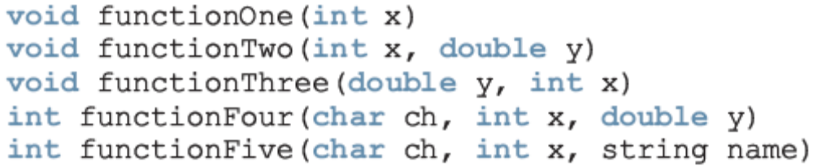
Function Overloading (cont'd.)
The following functions all have different formal parameter lists:
The following functions have the same formal parameter list:

Slide 48
Function Overloading (cont'd.)
Function overloading: creating several functions with the same name
The signature of a function consists of the function name and its formal parameter list
Two functions have different signatures if they have either different names or different formal parameter lists
Note that the signature of a function does not include the return type of the function

Slide 49
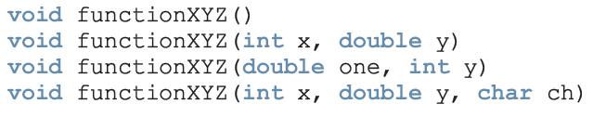

Function Overloading (cont'd.)
Correct function overloading:
Syntax error:

Slide 50
Function Overloading (cont'd.)
// Overloading Function LARGER
#include <iostream>
using namespace std;
// Function arguments are of different data type
int larger(int x, int y);
char larger(char first, char second);
int main()
{
int a, b;
char c, d;
cout << "Enter two integers\n";
cin >> a >> b;

Slide 51
cout << "The lerger number is: " << larger(a,b) << endl<<endl;
cout << "Enter two characters\n";
cin >> c >> d;
cout << "The lerger character is: " << larger(c,d) << endl<<endl;
}
int larger(int x, int y)
{
if(x>y)
return x;
return y;
}
char larger(char x, char y)
{
if(x>y)
return x;
return y;
}

Slide 52
Programming Example: Classify Numbers
In this example, we use functions to rewrite the program that determines the number of odds and evens from a given list of integers
Main algorithm remains the same:
  Initialize variables, zeros, odds, evens to 0
  Read a number
  If number is even, increment the even count
    If number is also zero, increment the zero count; else increment the odd count
  Repeat Steps 2-3 for each number in the list

Slide 53
Programming Example: Classify Numbers (cont'd.)
The program functions include:
  initialize: initialize the variables, such as zeros, odds, and evens
  getNumber: get the number
  classifyNumber: determine if number is odd or even (and whether it is also zero); this function also increments the appropriate count
  printResults: print the results

Slide 54
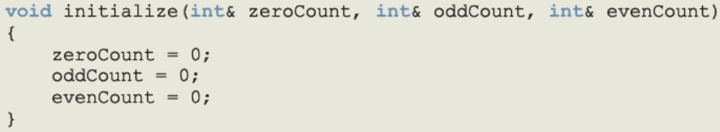
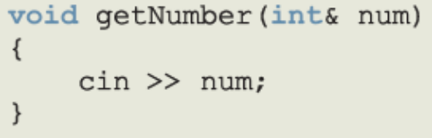
Programming Example: Classify Numbers (cont'd.)

Slide 55
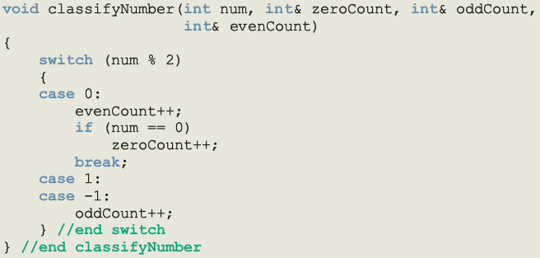
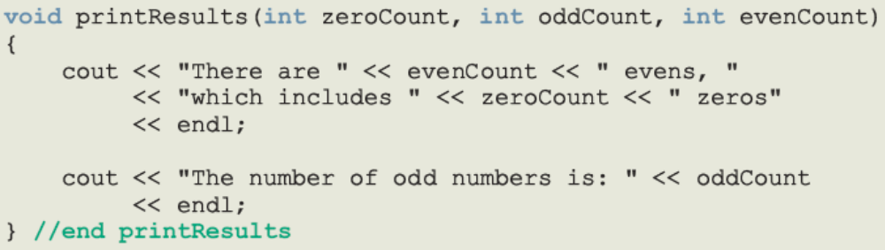
Programming Example: Classify Numbers (cont'd.)

Slide 56
Programming Example: Main Algorithm
Call initialize to initialize variables
Prompt the user to enter 20 numbers
For each number in the list
  Call getNumber to read a number
  Output the number
  Call classifyNumber to classify the number and increment the appropriate count
Call printResults to print the final results

Slide 57
Programming Example: Classify Numbers (cont'd.)
Example, P402 in Text

Slide 58
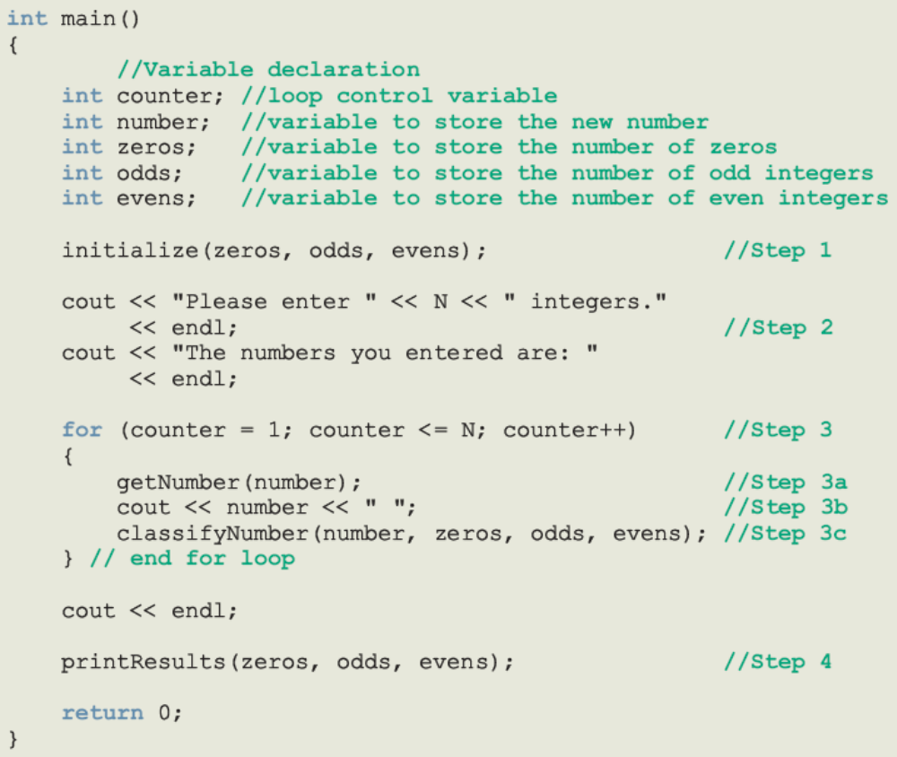
Programming Example: Main Algorithm (cont’d.)

